Slide 1
Post-quantum security of hash functions
Dominique Unruh
University of Tartu
Notes:
Abstract: In classical cryptography, one of the most important properties of hash functions is collision-resistance. We explain why collision-resistance is (often) not a sufficient requirement in the post-quantum setting, and present an alternative, the collapsing-property. We discuss the security of Merkle-Damgård-hashes (e.g., SHA2) and sponge-based hashes (e.g., SHA3): under which conditions are they collapsing? Finally, we study the "indifferentiability" of the sponge-construction (on which classical proofs are based), and present ongoing work for showing that the sponge-construction is not indifferentiable.

Slide 2
Hash functions
H
long input
short output
Integrity of data
Identification of files
Efficient signatures
Commitment schemes
etc.
Are common hash functions post-quantum secure?

Slide 3
Properties of hash functions
$$x_{1}$$
H
Collision resistance
Pseudo random generators/functions
“Random-oracle like”
$$y$$
$$x_{2}$$
H
H
more random
random
???
H
???
And more

Slide 4
Surprises with hash functions
Consider a hash function and a horse race
“Spicy Spirit” wins…
Player
$$H("spicy spirit", 231632)$$
Bookie
Player
$$231632$$
Bookie
$$$

Slide 5
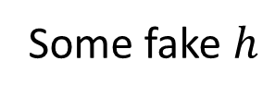
Surprises with hash functions (II)
Consider a cheating player
“Wallopping Waldo” wins…
Player
$$H("spicy spirit", 231632)$$
Bookie
Some fake $h$
Player
$r$ with $H\left(wallop,r\right)=h$
Bookie
$$$

Slide 6
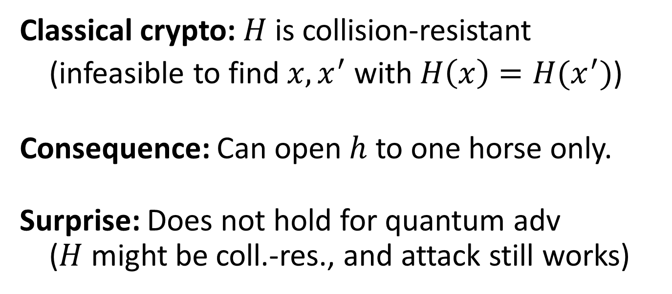
Surprises with hash functions (III)
Player
$r$ with $H\left(wallop,r\right)=h$
Bookie
Classical crypto: $H$ is collision-resistant
(infeasible to find$x,x^{′}$ with $H\left(x\right)=H(x^{′})$)
Consequence: Can open $h$ to one horse only.
Surprise: Does not hold for quantum adv ($H$ might be coll.-res., and attack still works)

Slide 7
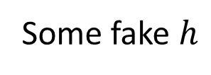
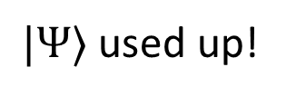
Surprises with hash functions (IV)
Player
Some fake $h$
Bookie
$$|Ψ〉$$
Player
$r$ with $H\left(wallop,r\right)=h$
Bookie
$|Ψ〉$ used up!
Notes:
Attack in:
Unruh, Computationally binding quantum commitments, Eurocrypt 2016

Slide 8
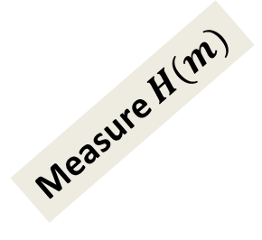
Collapsing hash functions
Strengthening of “collision-resistance” for quantum setting
Adv. A outputs messages $m$ (in superposition)
Def: Collapsing = A cannot distinguish
$$|m〉$$
$$|m〉$$
A
Measure $m$
A
or
A
Measure $H(m)$
A
Notes:
Definition in:
Unruh, Computationally binding quantum commitments, Eurocrypt 2016

Slide 9
Post-quantum hashes?
Question:
Are existing hashes post-quantum secure?
(E.g., SHA2, SHA3, etc.)
Collision-resistance?
Collapsing?
PRG/PRF?
…
This talk

Slide 10
How are hashes constructed?
A small building block:
Checked by cryptanalysis
Assumed ideal (e.g., random oracle)
An iterative construction:
With security proof
fixed len
fixed len
Compression function
Block function
f
Merkle-Damgård (e.g., SHA2)
Sponge (e.g., SHA3)

Slide 11
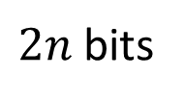
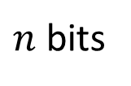
Security of Merkle-Damgård
Building block: Compression function
Idealized: random function
Random functions are collision-resistant / collapsing
We can assume f to be collapsing
$2n$ bits
f
$n$ bits
Notes:
Random functions are collapsing:
Unruh, Computationally binding quantum commitments, Eurocrypt 2016
Random functions are collision-resistant:
Zhandry, A note on the quantum collision and set equality problems, QIC, 2015

Slide 12
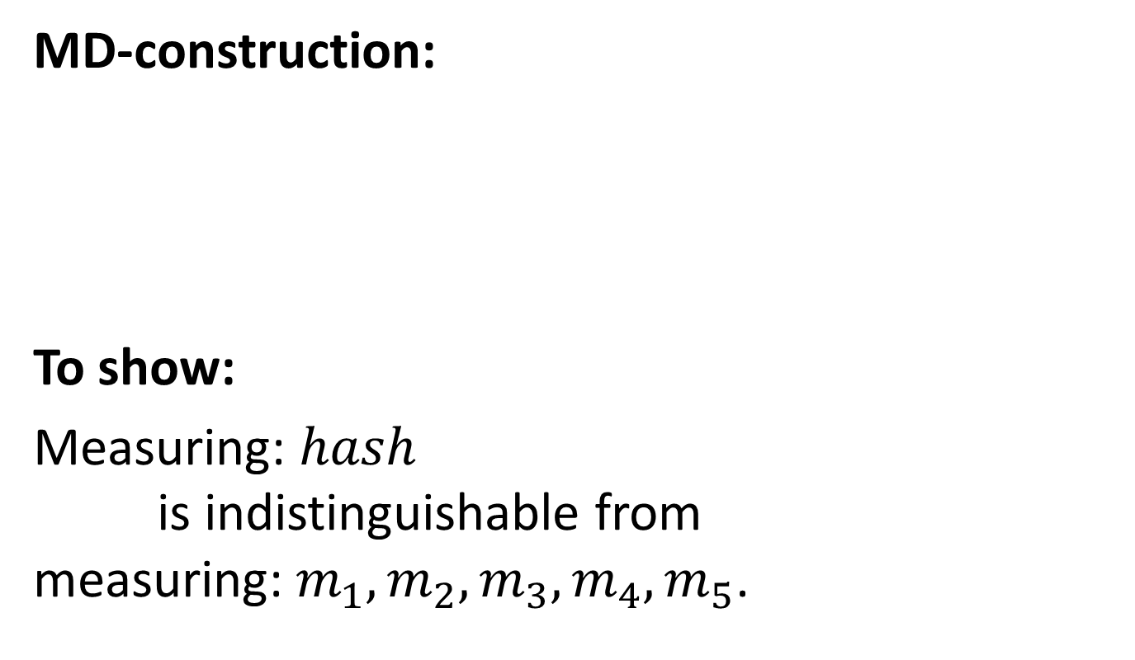
Security of Merkle-Damgård (II)
MD-construction:
To show:
Measuring: $hash$ is indistinguishable from measuring: $m_{1},m_{2},m_{3},m_{4},m_{5}$.
$$iv$$
f
f
f
f
f
$$hash$$
$$m_{1}$$
$$m_{2}$$
$$m_{3}$$
$$m_{4}$$
$$m_{5}$$
= measure
✓
Notes:
Merkle-Damgård is collapsing:
Unruh, Collapse-binding quantum commitments without random oracles, Asiacrypt 2016

Slide 13
Security of Merkle-Damgård (III)
One subtlety: Superpositions of messages of different lengths
We assumed known length
Measuring length → disturbs state?
Fortunately: padding has length in last block
$$iv$$
f
f
f
f
f
$$hash$$
$$m_{1}$$
$$m_{2}$$
$$m_{3}$$
$$m_{4}$$
$$m_{5}$$
$⇒$ SHA2 post-quantum secure (coll-res., collapsing)

Slide 14
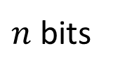
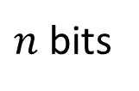
Security of sponges
Building block: Block function (or permutation)
Idealized: random function / permutation
Collision-resistant / collapsing when restricted to left/right half of output
Not true for invertible permutation!!!
$n$ bits
f
$n$ bits
SHA3
Notes:
Random functions are collapsing:
Unruh, Computationally binding quantum commitments, Eurocrypt 2016
Random functions are collision-resistant:
Zhandry, A note on the quantum collision and set equality problems, QIC, 2015

Slide 15
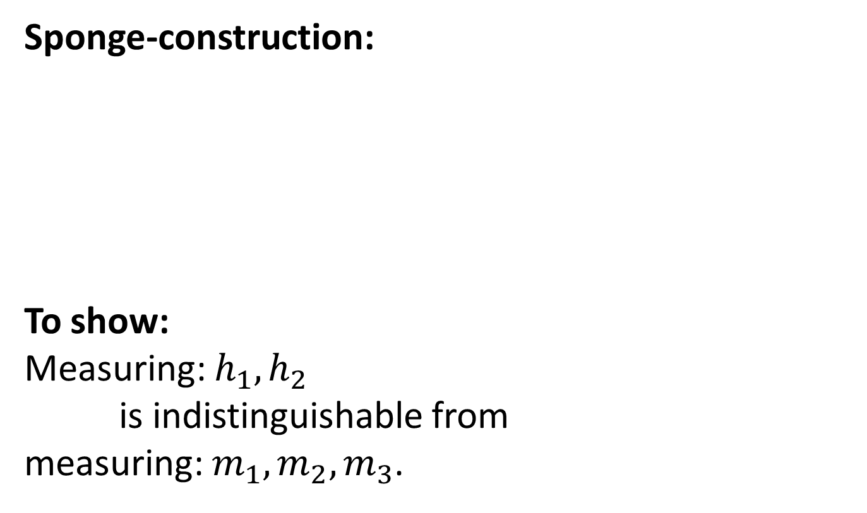
Security of sponges (II)
Sponge-construction:
To show:
Measuring: $h_{1},h_{2}$
is indistinguishable from
measuring: $m_{1},m_{2},m_{3}$.
$$m_{1}$$
$$m_{2}$$
$$m_{3}$$
$$h_{1}$$
$$h_{2}$$
$$0$$
f
f
f
f
$$0$$
= measure
✓
Notes:
Sponges are collapsing:
Unruh, Collapsing sponges: Post-quantum security of the sponge construction, Eprint 2016
Czajkowski, Groot Bruinderink, Hülsing, Schaffner, Quantum preimage, 2nd-preimage, and collision resistance of SHA3, Eprint 2016
J

Slide 16
Security of sponges (III)
Same subtlety: Superposition of different lengths
→ more tricky, but solvable
Conclusion:
Sponge hashes are collapsing/collision-resistant
But only if f not invertible!

Slide 17
Which sponges are post-quantum?
With non-invertible block function: ✓
E.g., Gluon hash function
With invertible block function: unknown
E.g., SHA3
Preferred by classical community (better parameters)?
What shall we prefer in post-quantum case???

Slide 18
Indifferentiability of sponges
Classically, sponges are indifferentiable
I.e., they have “the same properties” as random oracles
Collision-resistance and much more: trivial consequence
Time-saver approach: one proof for all
Notes:
Indifferentiability of sponges:
Bertoni, Daemen, Peeters, van Assche, On the Indifferentiability of the Sponge Construction

Slide 19
Indifferentiability: “Definition”
Real model
Ideal model
f
Sponge
f
Random oracle
fake
indistinguishable
Simulator must find f that “explains” the random oracle as a sponge.

Slide 20
Quantum indifferentiability of sponge
Real model
Ideal model
f
Sponge
f
Random oracle
fake
Queries to f in superposition $⇒$ simulator cannot adaptively fix f $⇒$ needs to fix all of f in a go
Counting argument: not enough different f’s
Half-proven conjecture

Slide 21
Main open problem
Understand sponges with invertible block function
Otherwise, no clue if SHA-3 post-quantum secure

Slide 22
I thank for your attention
This research was supported by European Social Fund’s Doctoral Studies and Internationalisation Programme DoRa

Slide 23
Postdoc Positions (also phd)
Verification of Quantum Crypto
Formal verification of quantum crypto protocols
(“QuEasyCrypt” tool)
http://tinyurl.com/postdoc-vqc

